Slide 1
SMART METER

Slide 2
Basic Details of the Team and Problem Statement
Theme Name: Renewable Energy
Problem Statement Title: Energy Management System
Team Name: Stellar
Team Leader Name: Jakkula Indra Karan Rao
Institute Name: CVR COLLEGE OF ENGINEERING

Slide 3
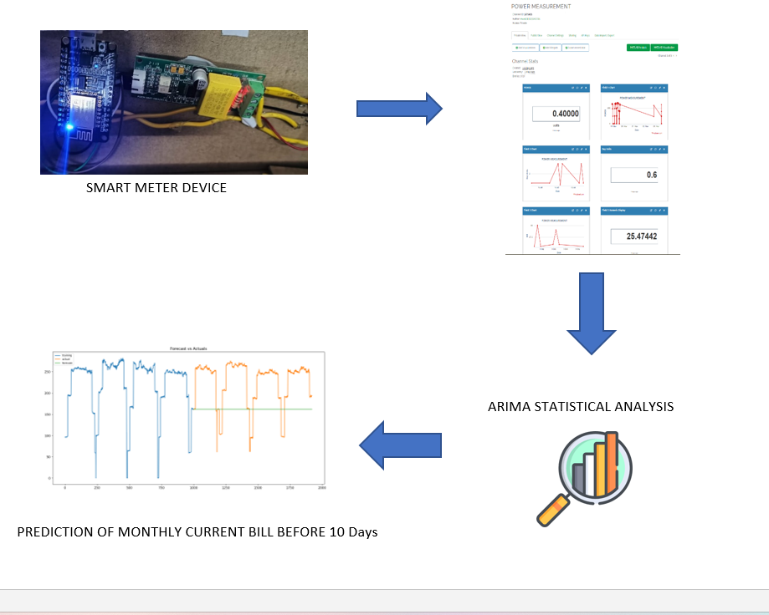
Idea/Approach Details
Describe your idea/Solution/Prototype here:
Developed a system which is capable to Generate Brief report regarding Day to Day Energy consumption and Alert the user about his limits to consume Energy Feasibly.
The IOT Device is installed at the Traditional Meters and Register in a Web application in order to receive the Alerts and Reports
The Report Consist of :
a) Day to Day Electricity Bill and amount of consumption
b) Predict the Monthly current Bill before 10days based on early consumption.
c) Redirect to UPI payments to complete the Monthly payment
Describe your Technology stack here:
PZEM - 004T
ESP8266
ThingSpeak (Mathworks cloud)
ARIMA Statistical model ( Prediction )
Web Application ( Alerts & Report )

Slide 4
Idea/Approach Details
Describe your Use Cases here
Describe your Dependencies / Show stopper here
Monitor Current Usage: Users can monitor their current electricity usage on a day-to-day basis.
Monthly Bill Prediction: The system can predict the monthly electricity bill based on the user's consumption history.
Usage Limits: Users can set up usage limits for their electricity consumption.
Alerts and Notifications: The system can send alerts and notifications to users when they are nearing or exceeding their usage limits.
IOT Modules
Thing Speak Cloud Server and API
Angular Web Frame Work
Statistical Analysis and Implementation in Python

Slide 5
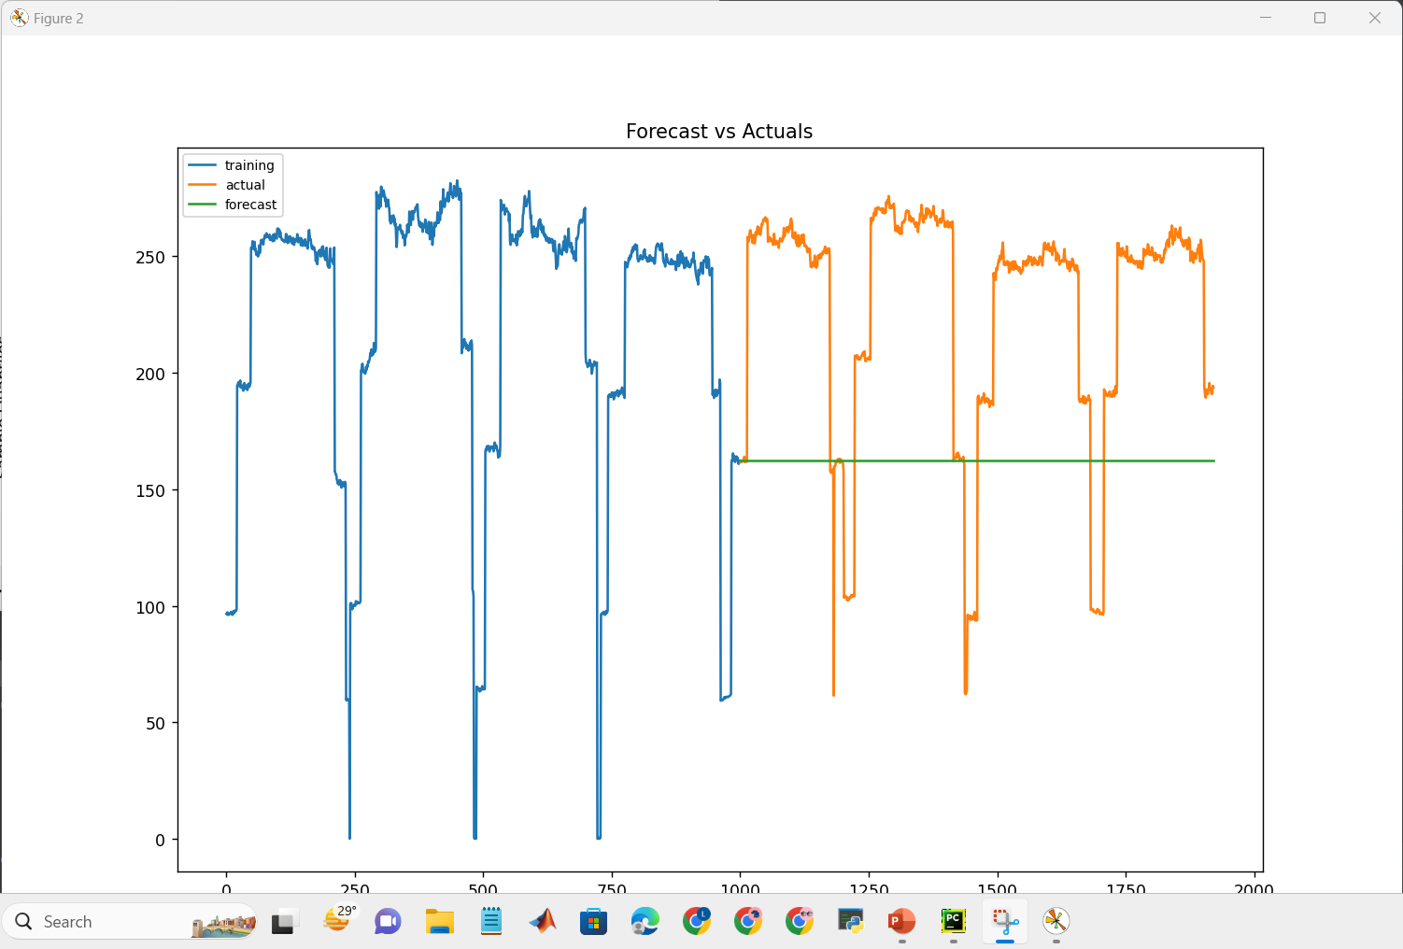
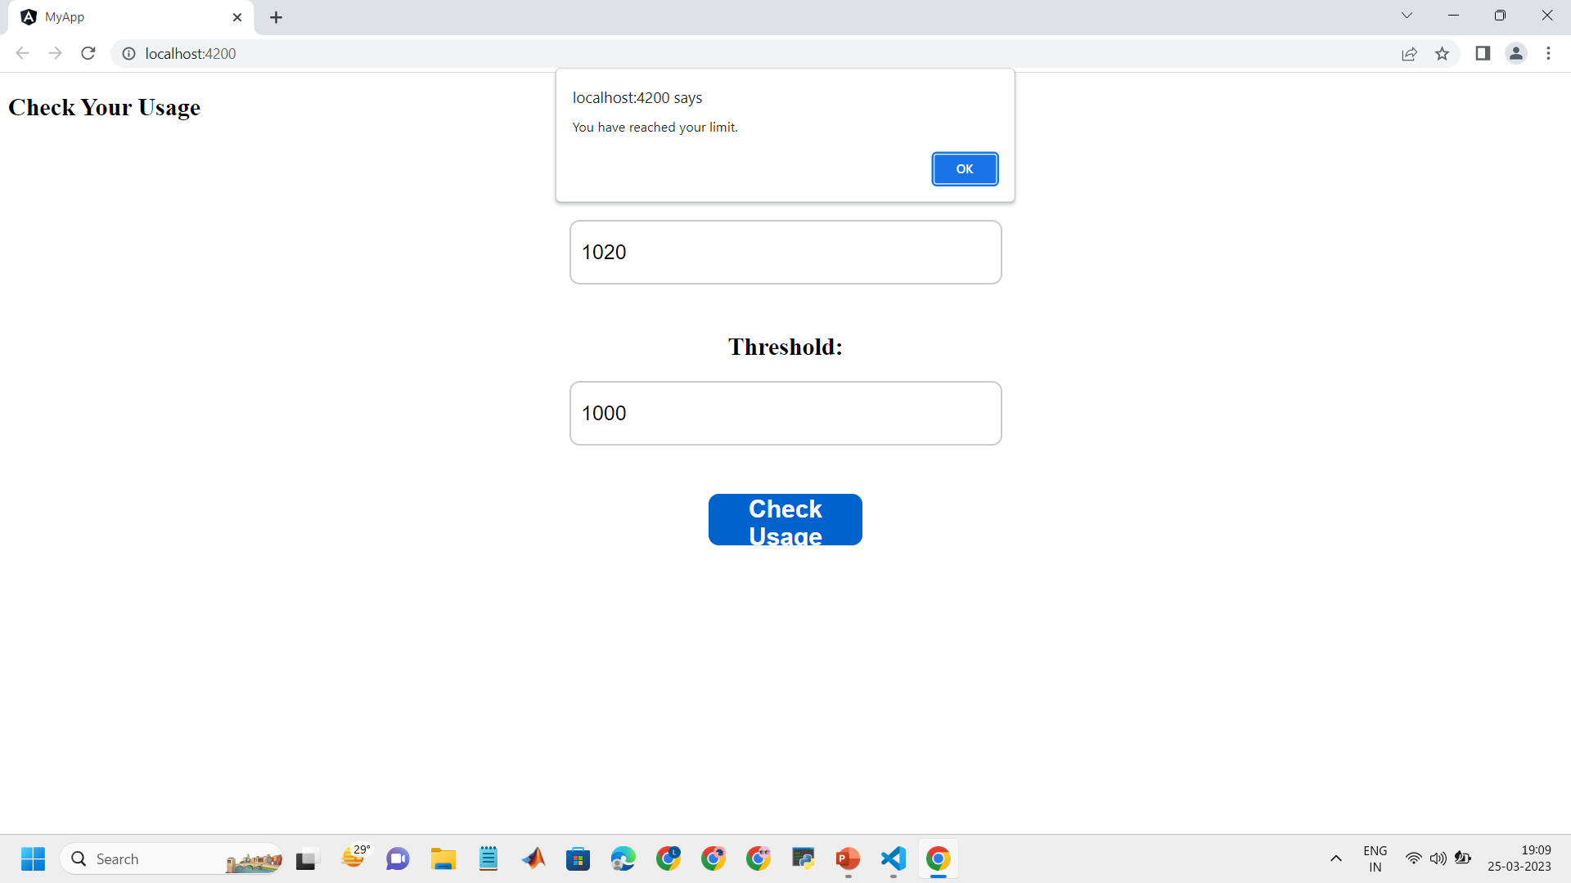
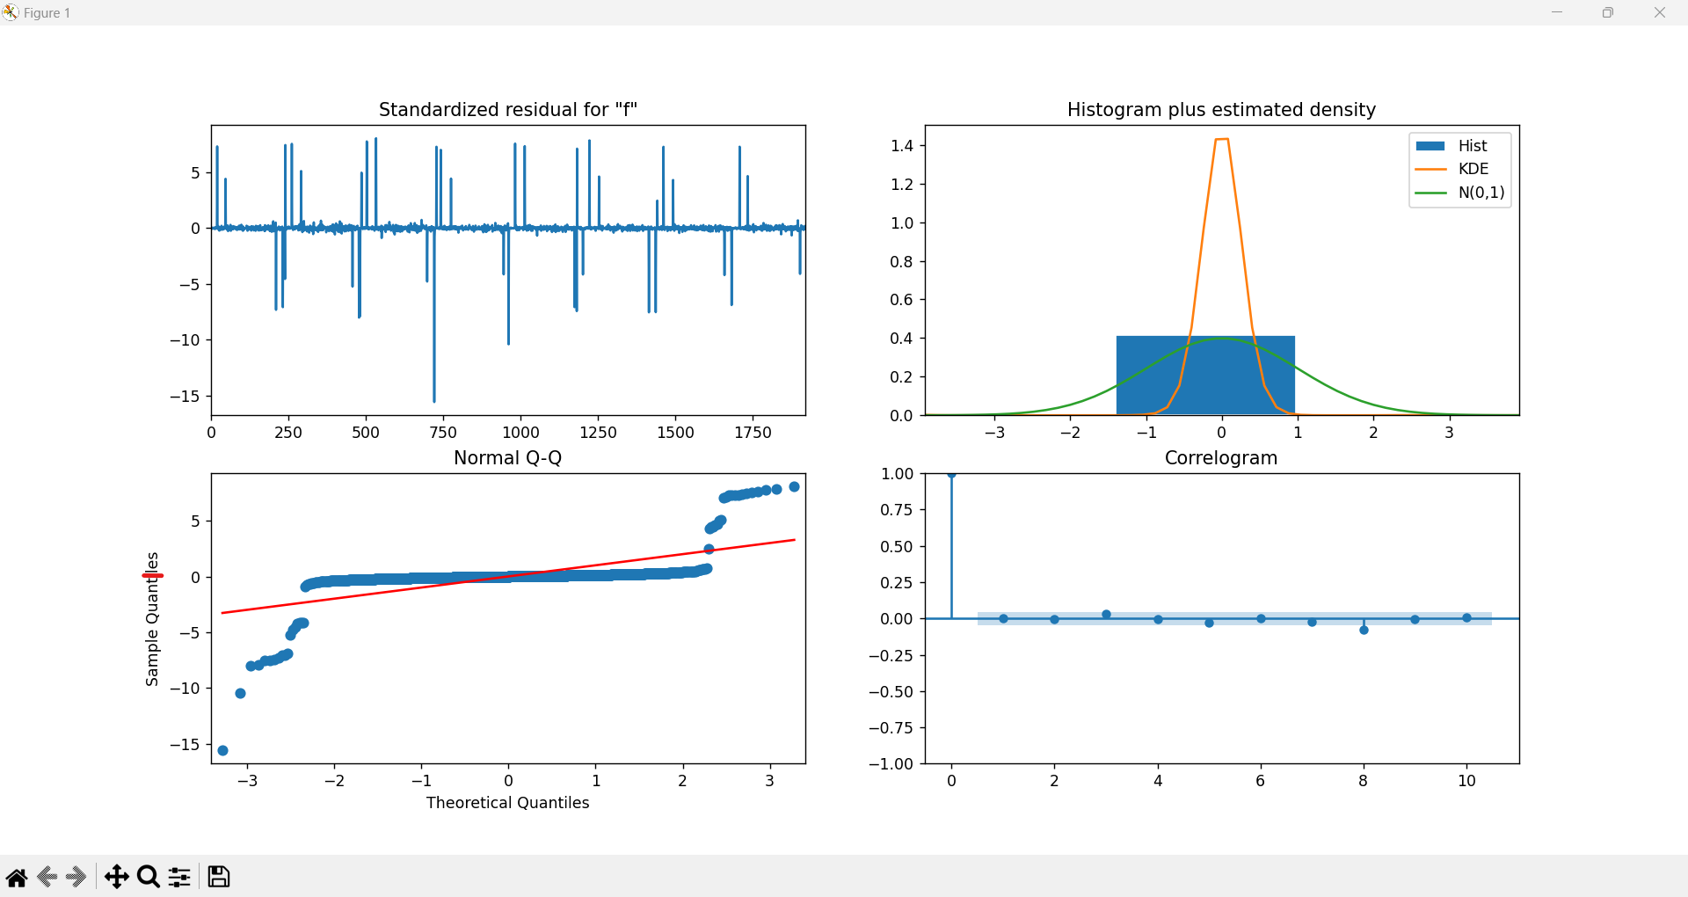
REPORT
Predictions
ALERTS
Day to Day Current Bill

Slide 6
Team Member Details
Team Leader: J INDRA KARAN RAO
Branch: Computer Science and Information Technology Year: IIIrd
Team Member 1: Ilapuram Srija
Branch: Computer Science and Information Technology Year: IIIrd
Team Member 2: Ganapuram Kavya
Branch: Computer Science and Information Technology Year: IIIrd
Team Member 3: Manikanta Raju Golusula
Branch: ECE Year: IIIrd

